Slide 1
Software Design and Analysis Introduction
Instructor: Mehroze Khan

Slide 2
What is Software Engineering?
Software engineering is the process of solving customers’ problems by the systematic development and evolution of large, high-quality software systems within cost, time and other constraints.

Slide 3
Stakeholders in Software Engineering
Users. These are the people who will use the software. Their goals usually include doing enjoyable or interesting work and gaining recognition for the work they have done.
Customers (also known as clients). These are the people who make the decisions about ordering and paying for the software. They may or may not be users – the users may work for them.
Software developers. These are the people who develop and maintain the software, many of whom may be called software engineers.
Development managers. These are the people who run the organization that is developing the software.

Slide 4
Software Development Lifecycle (SDLC)
The Software Development Life Cycle (SDLC) refers to a methodology with clearly defined processes for creating high-quality software. SDLC methodology focuses on the following phases of software development:
Requirement analysis
Planning
Software design such as architectural design
Software development
Testing
Deployment/Maintenance

Slide 5
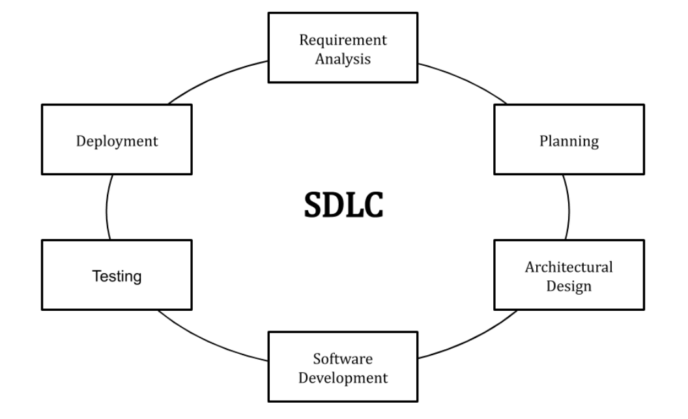
Software Development Lifecycle (SDLC)
Notes:
Requirement Analysis: involves getting input from all stakeholders, including customers, salespeople, industry experts, and programmers.
Planning: the team determines the cost and resources required for implementing the analyzed requirements. It also details the risks involved and provides sub-plans for softening those risks.
Design: starts by turning the software specifications into a design plan called the Design Specification. All stakeholders then review this plan and offer feedback and suggestions.
Development: the actual development starts by writing code.
Testing: we test for defects and deficiencies. We fix those issues until the product meets the original specifications.
Deployment/Maintenance: the goal is to deploy the software to the production environment so users can start using the product. During maintenance, as conditions in the real-world change, we need to update and advance the software to match.

Slide 6
OOP?
Object-oriented programming is a method of implementation in which programs are organized as cooperative collections of objects, each of which represents an instance of some class, and whose classes are all members of a hierarchy of classes united via inheritance relationships.
Notes:
There are three important parts to this definition:
Object-oriented programming uses objects, not algorithms, as its fundamental logical building blocks
Each object is an instance of some class, it is a tangible entity that exhibits some well-defined behavior
Classes may be related to one another via inheritance relationships

Slide 7
Object Oriented Design
Object-oriented design is a method of design encompassing the process of object-oriented decomposition and a notation for depicting both logical and physical as well as static and dynamic models of the system under design.
Notes:
Logical Models: These models represent the conceptual organization of the system, focusing on how objects relate to each other and what roles they play.
Example: Class Diagram
Physical Models: These models represent the real-world implementation, focusing on how the system will be physically organized, including how data is stored and accessed.
Example: Deployment Diagram
Static Models :These models capture the system's structure at a specific point in time, showing the static relationships between objects.
Example: Object Diagram, Package Diagram, Component Diagram
Dynamic Models: These models capture the behavior of the system over time, showing how objects interact and change as the system operates.
Example: Sequence Diagram

Slide 8
Object Oriented Analysis
Object-oriented analysis is a method of analysis that examines requirements from the perspective of the classes and objects found in the vocabulary of the problem domain.
Notes:
Instead of looking at the system as just a list of tasks or functions, OOA encourages you to think about the system in terms of objects. These objects represent the key things (people, places, things, concepts) involved in your problem.

Slide 9
Object Model
For all things object oriented, the conceptual framework is the object model. There are four major elements of this model:
1. Abstraction
2. Encapsulation
3. Modularity
4. Hierarchy
Notes:
A model without any one of these elements is not object-oriented.

Slide 10
Abstraction
An abstraction denotes the essential characteristics of an object that distinguish it from all other kinds of objects and thus provide crisply defined conceptual boundaries, relative to the perspective of the viewer.
An abstraction focuses on the outside view of an object and so serves to separate an object’s essential behavior from its implementation.

Slide 11
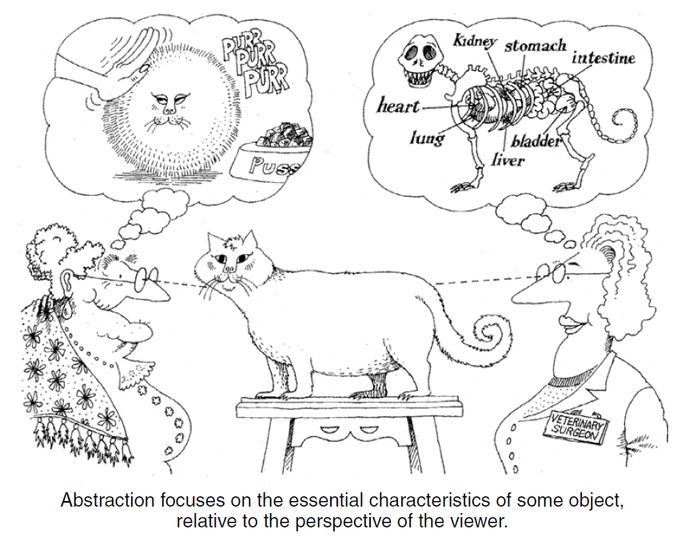
Abstraction

Slide 12
Abstraction
class Shape {
public:
virtual void draw() = 0; // Pure virtual function
};
// Derived class representing a circle
class Circle : public Shape {
public:
void draw() { // Implementation of draw for a circle
cout << "Drawing a circle." << endl;
}
};
// Derived class representing a rectangle
class Rectangle : public Shape {
public:
void draw() { // Implementation of draw for a rectangle
cout << "Drawing a rectangle." << endl;
}
};
int main() {
Circle circle; // Create a Circle object
Rectangle rectangle; // Create a Rectangle object
circle.draw(); // Output: Drawing a circle.
rectangle.draw(); // Output: Drawing a rectangle.
}

Slide 13
Encapsulation
It refers to the bundling of data (attributes) and methods (functions) that operate on the data into a single unit or class.
Encapsulation also involves restricting direct access to some of an object's components, which is a way to safeguard the internal state of the object from unintended interference and misuse.

Slide 14
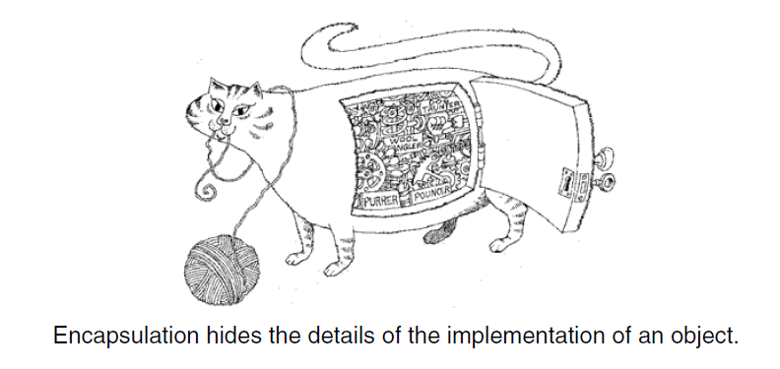
Encapsulation

Slide 15
Encapsulation
class BankAccount {
private:
string accountNumber;
double balance; // Private attribute
public:
BankAccount(string accNum, double initialBalance) {
accountNumber = accNum;
balance = initialBalance;
}
void deposit(double amount) {
if (amount > 0) {
balance += amount;
cout << "$" << amount << " deposited. New balance: $" << balance << endl;
}
}
void withdraw(double amount) {
if (amount > 0 && amount <= balance) {
balance -= amount;
cout << "$" << amount << " withdrawn. New balance: $" << balance << endl;
} else {
cout << "Insufficient balance" << endl;
}
}
double getBalance() {
return balance;
}
};
int main() {
BankAccount account("123456789", 500);
account.deposit(200);
account.withdraw(100);
cout << "Account balance: $" << account.getBalance() << endl;
}

Slide 16
Modularity
Partitioning a program creates a number of well-defined, documented boundaries within the program.
Modularization consists of dividing a program into modules which can be compiled separately, but which have connections with other modules.
The overall goal of the decomposition into modules is the reduction of software cost by allowing modules to be designed and revised independently
Notes:
A better solution is to group logically related classes and objects in the same module and to expose only those elements that other modules absolutely must see.

Slide 17
Modularity
// BankAccount.h
#ifndef BANKACCOUNT_H
#define BANKACCOUNT_H
#include <string>
class BankAccount {
private:
string accountNumber;
double balance;
public:
BankAccount(string accNum, double initialBalance);
void deposit(double amount);
void withdraw(double amount);
double getBalance() const;
};
#endif // BANKACCOUNT_H

Slide 18
Modularity
// BankAccount.cpp
#include "BankAccount.h"
#include <iostream>
BankAccount::BankAccount(string accNum, double initialBalance) {
accountNumber = accNum;
balance = initialBalance;
}
void BankAccount::deposit(double amount) {
if (amount > 0) {
balance += amount;
cout << "$" << amount << " deposited. New balance: $" << balance << endl;
}
}
void BankAccount::withdraw(double amount) {
if (amount > 0 && amount <= balance) {
balance -= amount;
cout << "$" << amount << " withdrawn. New balance: $" << balance << endl;
} else {
cout << "Insufficient balance" << endl;
}
}
double BankAccount::getBalance() const {
return balance;
}

Slide 19
Modularity
// main.cpp
#include <iostream>
#include "BankAccount.h"
int main() {
BankAccount account("123456789", 500);
account.deposit(200);
account.withdraw(100);
cout << "Account balance: $" << account.getBalance() << endl;
}

Slide 20
Hierarchy
Hierarchy is a ranking or ordering of abstractions.
The two most important hierarchies in a complex system are its class structure (the “is a” hierarchy) and its object structure (the “part of” hierarchy).
Examples of Hierarchy
Single Inheritance (is a hierarchy)
Multiple Inheritance (is a hierarchy)
Clashes will occur when two or more super classes provide a field or operation with the same name or signature as a peer superclass.
Repeated inheritance occurs when two or more peer super classes share a common superclass. In such a situation, the inheritance lattice will be diamond-shaped, so the question arises, does the leaf class (i.e., subclass) have one copy or multiple copies of the structure of the shared superclass?
Aggregation (part of hierarchy)
Notes:
Aggregation permits the physical grouping of logically related structures, and inheritance allows these common groups to be easily reused among different abstractions.

Slide 21
Hierarchy (Single Inheritance)
// Base class
class Animal {
public:
void eat() {
cout << "This animal is eating." << endl;
}
};
// Derived class
class Dog : public Animal {
public:
void bark() {
cout << "The dog is barking." << endl;
}
};
int main() {
Dog myDog;
myDog.eat();
myDog.bark();
}

Slide 22
Hierarchy (Aggregation)
// Part class
class Engine {
public:
void start() {
cout << "Engine started." << endl;
}
};
// Whole class
class Car {
private:
Engine engine; // Engine is a part of Car
public:
void start() {
engine.start(); // Start the engine when the car starts
cout << "Car started." << endl;
}
};
int main() {
Car myCar;
// Car is composed of an Engine, so starting the car also starts the engine
myCar.start(); // Output: Engine started. Car started.
return 0;
}

Slide 23
Diamond Problem
class A {
public:
void display() {
cout << "A's display()" << endl;
}
};
class B : public A {
// No override of display()
};
class C : public A {
// No override of display()
};
class D : public B, public C {
// No override of display()
};
int main() {
D obj;
obj.display(); // Which display() should be called?
return 0;
}

Slide 24
Solution in C++ (Virtual Inheritance)
class A {
public:
virtual void display() {
cout << "A's display()" << endl;
}
};
class B : public virtual A {
// No override of display()
};
class C : public virtual A {
// No override of display()
};
class D : public B, public C {
// No override of display()
};
int main() {
D obj;
obj.display(); // Which display() should be called?
return 0;
}

Slide 25
Benefits of Object Model
Use of the object model:
Helps us to exploit the expressive power of object-based and object-oriented programming languages
Encourages the reuse not only of software but of entire designs, leading to the creation of reusable application frameworks
Produces systems that are built on stable intermediate forms, which are more resilient to change
Appeals to the workings of human cognition

Slide 26
Object Oriented Methodology
The methodology has the following stages.
System conception. Software development begins with business analysts or users conceiving an application and formulating tentative requirements.
Analysis. The analyst scrutinizes and rigorously restates the requirements from system conception by constructing models. The analyst must work with the requestor to understand the problem, because problem statements are rarely complete or correct.
The analysis model has two parts: the domain model, a description of the real-world objects reflected within the system; and the application model, a description of the parts of the application system itself that are visible to the user.
System design. The development team devise a high-level strategy—the system architecture— for solving the application problem.
Class design. The class designer adds details to the analysis model in accordance with the system design strategy. The class designer elaborates both domain and application objects using the same OO concepts.
Implementation. Implementers translate the classes and relationships developed during class design into a particular programming language, database, or hardware.

Slide 27
References
Object-Oriented Analysis and Design with Applications, Grady Booch et al., 3rd Edition, Pearson, 2007.
Timothy C. Lethbridge, Robert Laganaiere, Object-Oriented Software Engineering (2nd Edition), McGraw Hill, 2005
Object-Oriented Modeling and Design with UML, Michael R. Blaha and James R. Rumbaugh, 2nd Edition, Pearson, 2005.

